Slide 1

Intelligent Inventory Management System
Name: Md Najmol hasan
ID: 30082892
Faculty of Computing, Engineering and Science
University of South Wales
Professor Name: Dr. Ian Wilson
Faculty of Computing, Engineering and Science
University of South Wales

Slide 2

PROJECT DETAILS
Introduction
Project Aims and Objectives
Document outline
Methodology
System Design and Implementation
Database Design
User Interface Design
Implementation Process
Evaluation Process
Conclusion and Future Work

Slide 3
INTRODUCTION
Thus, inventory management is a pivotal factor when it comes to competitiveness and customer satisfaction in the constantly changing environment of modern business. Innovations in supply chain and changing consumption patterns have made it difficult for traditional inventory management systems that use manual record and historical information to operate effectively. The Intelligent Inventory Management System project arises from these challenges with an ambitious goal of designing and implementing a modern software system based on artificial intelligence and machine learning to improve inventory management.
These processes will be integrated and made automatic through the proposed system and have the features of giving real time information of the stock, control of inventories, reduction of wastage as well as having control data base that can be accessed by the different levels of users. The Intelligent Inventory Management System can be said to be a monumental advancement in inventory control solutions

Slide 4
PROJECT AIMS AND OBJECTIVES
Conduct extensive research on existing inventory management systems and AI technologies currently used in this domain.
Select appropriate AI technologies for intelligent inventory management.
Integrate the system with existing Enterprise Resource Planning (ERP) solutions.
Conduct rigorous testing and system validation.
Deploy the system and evaluate its performance.
Document the evaluation process and highlight core findings.
Prepare a comprehensive user manual.
Establish a plan for regular maintenance, support, and future updates.

Slide 5
DOCUMENT OUTLINE
This dissertation explores the development of an Intelligent Inventory Management System. It begins with an introduction outlining the project's aims and objectives. The literature review follows, covering traditional inventory management systems, AI and machine learning applications, real-time tracking with IoT integration, and associated challenges and ethical considerations. The methodology section details the research approach, system design, technology selection, development process, testing, and evaluation methods. System design and implementation are then discussed, including architecture, key features, database design, machine learning models, user interface, and implementation process. The document concludes with testing and evaluation procedures, followed by a summary of achievements, limitations, future work, and concluding remarks.

Slide 6
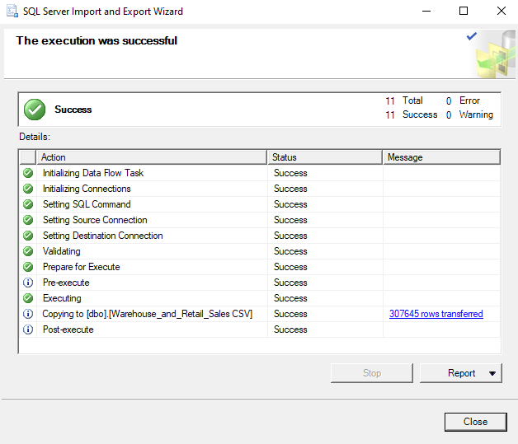
SYSTEM DESIGN AND IMPLEMENTATION
Dataset Importing and Explaining

Slide 7
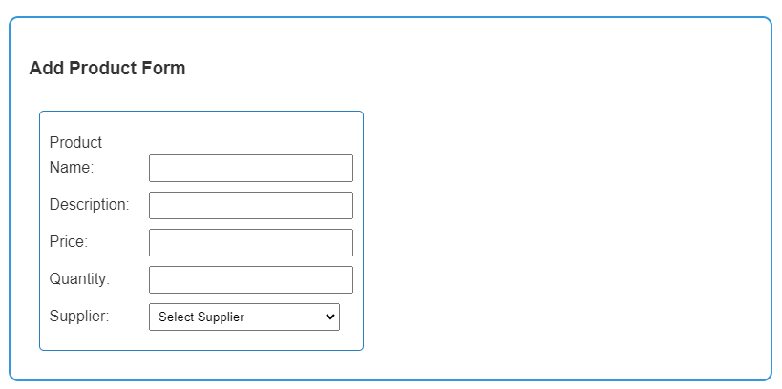
Database Design
Build Inventory Management Database

Slide 8
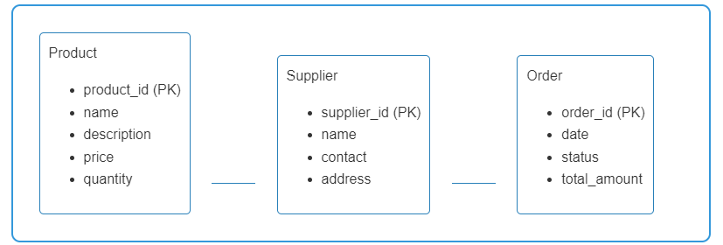

USER INTERFACE DESIGN
ENTITY RELATIONSHIP DIAGRAM
INVENTORY MANAGEMENT

Slide 9
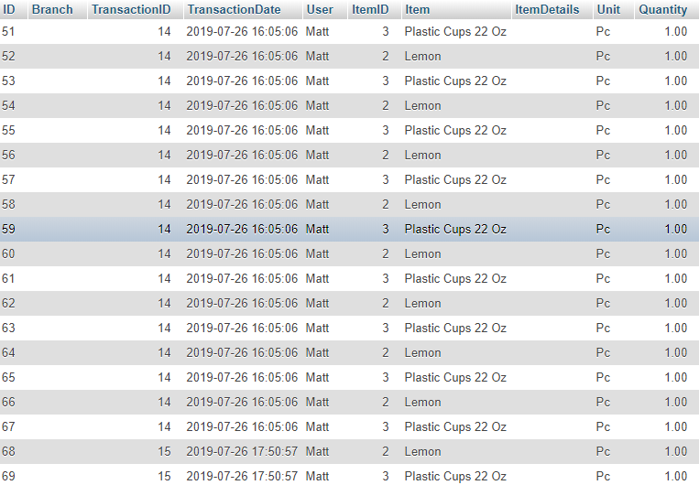
IMPLEMENTATION PROCESS
Overview of the inventory table

Slide 10
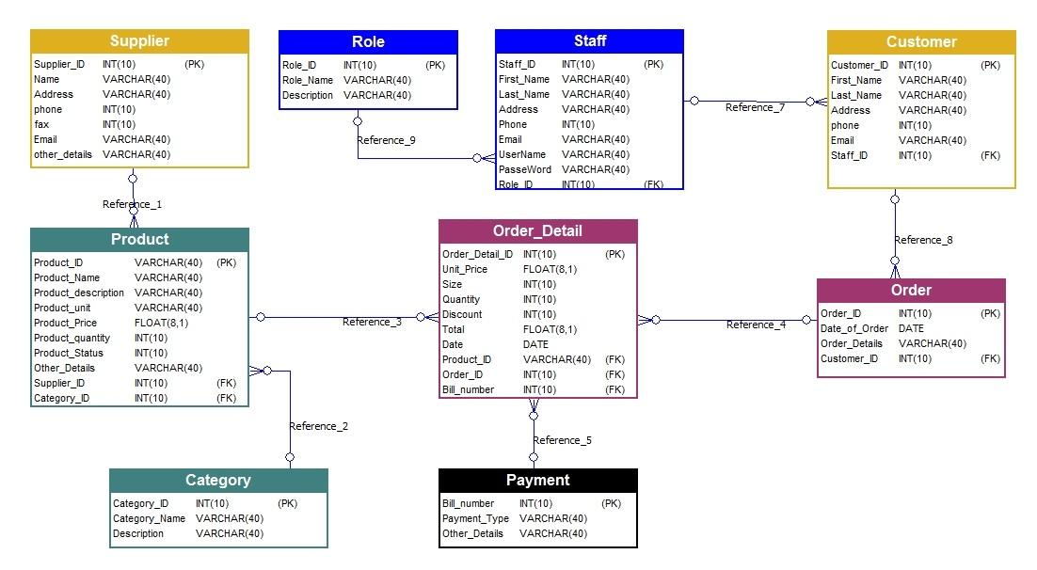
Evaluation Process

Slide 11
Conclusion and Future Work
The Intelligent Inventory Management System project can be considered as one of the most exciting and valuable projects for the development of inventory management as a field of study and as a practice, because it combines the best features of artificial intelligence and machine learning to address the issues that modern businesses struggle with.
The future work on the Intelligent Inventory Management System can be enhanced in several ways to be made bigger in the future. In future research, it is also possible to develop more complex predictive models, which include other factors that may influence the demand for products.

Slide 12
THANK YOU!

